Slide 1


First Day of Class

Slide 2
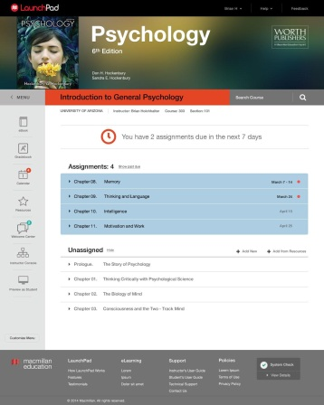
What is LaunchPad?
LaunchPad is an online course space that includes:
Interactive e-Book
Engaging multimedia
Effective study tools
Loads of quizzing

Slide 3
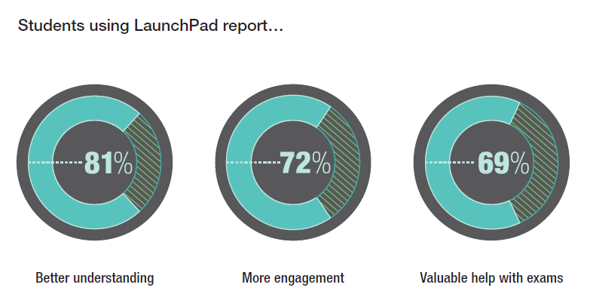
What are other students saying about it?

Slide 4
What can LaunchPad do for you?
Improve your understanding of the course content.
Get you engaged in the course.
Help you prep for your tests and quizzes.
GET A BETTER GRADE!

Slide 5
So how can you get into LaunchPad?
  Enter an access code that you already bought.
  Buy access online.
  Check out LaunchPad with 21-day trial access.

Slide 6
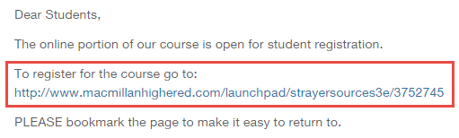
What’s this about a course URL?
  Your instructor may have already emailed or posted the course URL.
    Got the URL? Click on the link or paste it into a browser.
    No URL?
      Request the URL from your instructor.
      OR
      Use the Find Your LaunchPad menu under the Students heading at www.launchpadworks.com to enter your state, city, institution, and instructor.

Slide 7
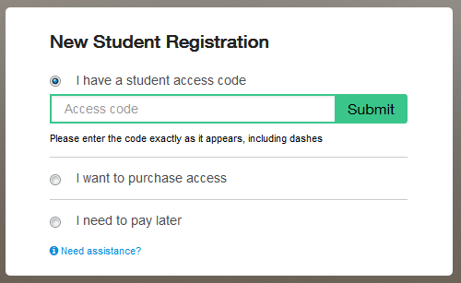
Got an access code?
    Select “I have a student access code.”
    Enter the code exactly as it appears on the card.
    Click “Submit.”

Slide 8
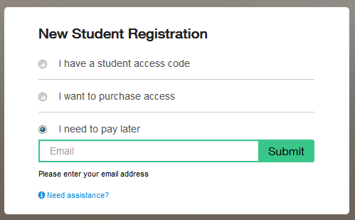
Not ready to purchase access?
  Need to start working but can’t purchase now?
  Select “I need to pay later.”
  Enter your email address and click “Submit.”

Slide 9

Where can you get more help?
If you have issues with your account, course content, or tools, contact Macmillan Learning Technical Support.
Website: macmillanlearning.com/support
Phone: 1-800-936-6899
Online form: http://www.macmillanlearning.com/Catalog/techsupport
Technical Support Hours (Eastern Time)
Monday through Thursday 8:00 a.m. to 3:00 a.m.
Friday 8:00 a.m. to midnight
Saturday noon to 8:00 p.m.
Sunday noon to 3:00 a.m.

